Slide 1
The Generalized Random Tessellation Stratified Method for Selecting Spatially-Balanced Probability Samples

Slide 2
Historical Context
In response to the concern over acid precipitation in the 1980’s, The National Acid Precipitation Assessment Program (NAPAP) conducted several nation-wide surveys of the acidification status of surface waters
These were the first national-level, probability-based surveys of the condition of an environmental resource

Slide 3
Historical Context
A number people who had worked on the NAPAP assessment were convinced that the US needed a national-level assessment of the condition of all environmental resources, based on a rigorous probability-based sampling design.

Slide 4
Historical Context
The Environmental Monitoring and Assessment Program (EMAP) was started by the USEPA in 1990 to develop
assessment methodology to measure condition
statistical methodology to design and analyze large-scale environmental surveys

Slide 5
Spatial Survey Design
Survey Design for Natural Resources
Spatial relationships in population are critical
Elements near one another tend to share
substrate, climate, topography
natural and anthropogenic stressors
Efficient designs spread out sample points

Slide 6
Spatial Survey Design
Tobler's First Law of Geography: Things that are close together in space tend to have more similar properties than things that are far apart.
OR
Spatial correlation functions tend to decrease with distance

Slide 7
Basic Spatial Design
Simple random sampling
Points selected independently of one another
Spatial stratification
Strata can be regular geometric figures (grid cells), arbitrary polygons (ecoregions), political boundaries (state borders), or natural boundaries (watersheds)

Slide 8
Basic Spatial Design
Systematic (spatial) sample
Sampling sites determined by the grid points located on a regular grid

Slide 9
Historical Context
EMAP statistical approach was founded on the concepts that
Spatial relationships in population are critical
Sampling, analysis, and reporting would be carried out at multiple spatial scales, from local to statewide to national to global

Slide 10
Historical Context
EMAP’s emphasis on spatial relationships & scale led to the consideration of a hierarchical system of regular grids
Nested grids facilitate aggregation/disaggregation of information
Regularity of grid-based sampling leads to more efficient sampling

Slide 11
Historical Context
Over large (e.g., continental or global) scales, curvature of the Earth limits the density of regular grids
The nodes of a regular global grid correspond to the vertices of a regular polyhedron
There only 5 possible regular polyhedra
Tetrahedron, Cube, Octahedron, Dodecahedron, and Icosahedron

Slide 12
Historical Context
The more sides the better, because the regular grid constructed on the side will be projected onto the globe’s surface, which unavoidably results in distortion

Slide 13
Regular Icosahedron
20 Triangular faces, 12 vertices

Slide 14
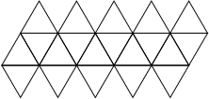
Cut along triangular faces that meet at the poles, and down from the north pole to the south pole, and unfold

Slide 15
We can now subdivide the triangular faces into smaller triangles. Note that there is a discontinuity along the cut lines.

Slide 16
Note that six triangles can be grouped into a hexagon

Slide 17
Historical Context
An icosahedron does not have enough faces to be really useful as a global grid, so we looked at ways to get more faces
One way is to slice off each vertex (where five triangles come together. The resulting figure is a “truncated icosahedron”
Result is a solid with 20 hexagonal faces and twelve pentagonal faces.

Slide 18
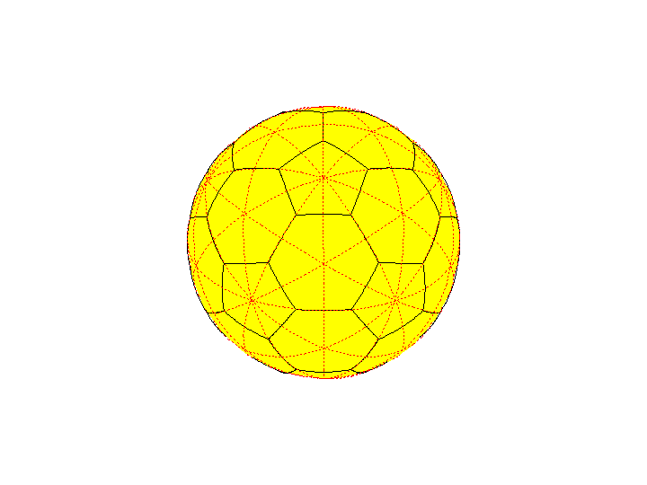
Truncated Icosahedron

Slide 19
Location of original triangular faces on
truncated icosahedron
Truncated Icosahedron

Slide 20
Historical Context
EMAP began with a global perspective: the USA was covered with one hexagonal face of a truncated icosohedron projected onto the Earth
This leads naturally to systematic design based on a randomly-placed triangular grid with associated hexagonal tessellation

Slide 21
Historical Context
Triangular grid has several advantages
More compact than square grid
Expected to intensify grid as needed, e.g., to increase the spatial density of grid points
More subdivision factors than square grid

Slide 22
Grids
A regularly spaced grid can be based on
Equal distance between lines covering the grid
= Square grid
Equal distances between adjacent points
= Triangular grids

Slide 23
Grids and Tessellations
A tessellation partitions the target area into disjoint polygons
Grids have associated tessellations
One possibility is to make the partitioning so the tessellation area contains all of the points nearest the grid point
A square grid produces a square tessellation
A triangular grid produces a hexagonal tessellation
Other associated tessellations are possible

Slide 24
Grids & Tessellations

Slide 25
TRIANGULAR GRID

Slide 26
Grid Intensification
Add points to an existing grid in such a manner as to obtain a denser regular grid
Starting from a base grid, have each point give rise to several new points.

Slide 27
Grid Intensification
For a triangular grid, the factors that give proper multiples of the base density are given by the relationship κ = a² + ab + b², a,b are non-negative integers
For a square grid, the relationship is κ = a² +b²

Slide 28
Triangular Grid Intensified 3-fold

Slide 29
Triangular Grid Intensified 4-fold

Slide 30
Triangular Grid Intensified 7-fold

Slide 31
Historical Context
Scott Overton, Denis White, Jon Kimmerling developed EMAP’s triangular grid + hexagonal tessellation

Slide 32
Disadvantages with Truncated Icosahedron
Singularities at boundaries
Hexagons do not nest
Grids exist at multiple resolutions
But tessellations associated with different resolution do not nest
Makes reporting/analyzing at different scales difficult
Pentagons don’t have the “nice” properties that hexagons do

Slide 33
Historical Context
GRTS design evolved from EMAP work on global tessellations in the early 1990’s
Became clear that basic concept did not have enough flexibility to accommodate the characteristics of environmental resource sampling

Slide 34
Sampling Natural Resource Populations
Patterned response (gradients, patches, periodic responses)
Variable inclusion probability
0, 1, 2, and 3- dimensional populations (points, lines, areas, & volumes)
Pattern in population occurrence (density )
Unreliable frame material

Slide 35
Spatial Survey Design
Patterned response (gradients, patches, periodic responses)
Variable inclusion probability
Ecological importance, economic importance, environmental stressor levels, scientific interest, and political importance are not uniform over the extent of the resource

Slide 36
Spatial Survey Design
Pattern in population occurrence (density)
Stream or lake density (NE US versus Western US)

Slide 37
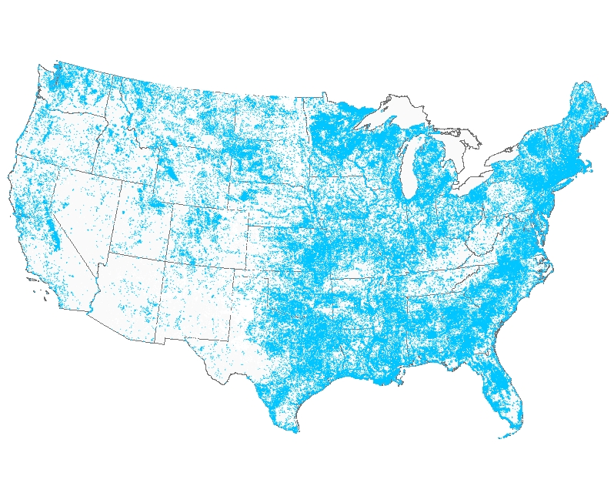
Centroids of lakes/reservoirs in the US

Slide 39
Spatial Survey Design
Unreliable frame material
Access difficulty
Temporal panels for trend assessment
Goals/objectives evolve

Slide 40
Sampling Natural Resource Populations
Natural Resource Populations exist in a spatial matrix
Population elements close to one another tend to be more similar than widely separated elements
Good sampling designs tend to spread out the sample points more or less regularly
Uniform random sampling tends to exhibit uneven spatial patterns

Slide 41
Desirable Properties of Natural Resource Samples
(1) Accommodate varying spatial sample intensity
(2) Spread the sample points evenly and regularly over the domain, subject to (1)
(3) Allow augmentation of the sample after-the-fact, while maintaining (1) & (2)
(4) Accommodate varying population spatial density for finite & linear populations, subject to (1) & (2).

Slide 42
Spatial Survey Design
Standard survey design methodology not well-suited natural resource populations
Overwhelming emphasis on finite populations
Most natural resource populations are naturally conceptualized as continua of points
Can discretize
stream networks by chopping into fixed-length segments or variable length reaches, but difficult to retain spatial relationships
forest or estuary into finite collection of cells, but cells don’t have a natural or ecological interpretation
Inference is then to number, not extent, e.g., number of reaches, of miles of stream

Slide 43
Basic Spatial Survey Designs
Systematic sample
Regular grid for extensive resource
Boundaries?
Regular spacing on linear resource
Confluences?
Finite resource?

Slide 44
Basic Spatial Survey Designs
Systematic sample
Periodic response ⇒ high variance
Less well recognized problem: patch-like response ⇒ high variance
Inflexible sample point density, with respect to both inclusion probability and sample adjustment for frame errors

Slide 45
Basic Spatial Survey Designs
Spatially stratified
Strata can be regular geometric figures (grid cells), arbitrary polygons (ecoregions), political boundaries (state borders), or natural boundaries (watersheds)
Maximum regularity ⇒
few ( 1 or 2) samples per stratum
equal number/length/area in each stratum
Good spatial control, but few samples/strata limit flexibility
Strata formation can be difficult
Notes:
For statistical reasons, sensible to keep strata size & number of samples the same, and number of samples per stratum small

Slide 46
Basic Spatial Survey Designs
Spatial ordering
Serpentine strips
National Agricultural Statistical Service
Graph-theoretical
Saalfeld, 1991
Peano order (Morton order)
Wolter, 1990

Slide 47
RANDOM-TESSELLATION STRATIFIED (RTS) DESIGN
Compromise between systematic & SRS that resolves periodic/patchy response
Cover the population domain with a grid
Randomly located
Regular (square or triangular)
Spacing chosen to give required spatial resolution
Tile the domain with equal-sized regular polygons containing the grid points
Select one sample point at random from each tessellation polygon

Slide 48
RTS DESIGN
Does not resolve systematic sample difficulties with
variable probability
finite & linear populations
pattern in population occurrence (density)
unreliable frame material

Slide 49
Generalized Random-Tessellation Stratified (GRTS) Design
Can achieve variable density by creating a series of nested grids, ordering the RTS points following the nesting, and then sub-sampling.
If we carry the process to the limit, letting the grid cell size → 0, the result is a function f: R² →R. We use this feature to develop a generalization of the RTS design that has all the features we wanted.

Slide 50
GRTS Design
Conceptual structure:
Population indexed by points contained within a region R
Have inclusion probability π(s) defined on R
Select a sample by picking points
Finite: points represent units
π(s) is usual inclusion probability
Linear: points on the lines
π(s) is a density: E(#sample points) /unit length
Extensive: points are in region area
π(s) is a density: E(#sample points)/unit area

Slide 51
GRTS Design Mechanics
Map R into first quadrant of unit square, & add a random offset
Subdivide unit square into “small” grid cells
At least small enough so that total inclusion probability for a cell (expected number of samples in the cell) is less than 1
Total inclusion probability for cell is sum or integral of π(s) over the extent of the cell

Slide 52
Population region image

Slide 53
Population region image + random offset
1.0
0.8
0.6
0.4
0.2
0.0
0.0
0.2
0.4
0.6
0.8
1.0

Slide 54
Population region image + random offset
1.0
0.8
0.6
0.4
0.2
0.0
0.0
0.2
0.4
0.6
0.8
1.0

Slide 55
Population region image + random offset
1.0
0.8
0.6
0.4
0.2
0.0
0.0
0.2
0.4
0.6
0.8
1.0

Slide 56
GRTS Design Mechanics
Order the cells so that some 2-dimensional proximity relationships are preserved, and let the cell size go to zero
Result is a map form unit square to unit interval
Can’t preserve everything, because a 1-1, onto, continuous map from unit square to unit interval is impossible
Can get 1-1,onto, & measurable, which is good enough
GRTS uses a quadrant-recursive function, similar to the space filling curve developed by Guiseppe Peano in 1890.

Slide 57
Assign each cell an address corresponding to the order of subdivision
The address of the shaded quadrant is 0.213
Order the cells following the address order

Slide 58
GRTS Design Theory
The function we just described is an example of a “quadrant recursive function”
The defining property of a Q-R function is that the image of any sub-quadrant, no matter how small, is an interval.

Slide 59
GRTS Design Theory
We will base the development on functions that map the unit square into the unit interval.
With suitable restrictions, we can make f continuous, 1-1, onto, or measureable, but not all at the same time. We choose a restriction that makes f (and f ⁻¹ ) 1-1, onto, measureable, and having a property that preserves some 2-dimensional proximity relationships in the 1-dimensional image

Slide 60
QUADRANT-RECURSIVE FUNCTIONS
A basic quadrant-recursive function can be obtained by bit-interweaving:
Let s = (x, y) be a point in the unit square
Binary expansion: x = 0.x₁x₂x₃...,
y = 0.y₁y₂y₃...,
where each x_{i} and y_{i} is either 0 or 1.

Slide 61
Quadrant-Recursive Functions
Define f₀(s) by alternating successive digits of x and y: f₀(s) = 0.x₁y₁x₂y₂....
Need to be careful: The same number can have different binary expansions:
0.1 = 0.01111111111111111111..........
If we always use the representation with an infinite number of 1's, then f₀ is 1-1 and onto the unit interval.

Slide 62
f0(s) is the function that would be obtained by carrying the illustrated subdivision to the limit, i.e., to cell size zero.

Slide 63
QUADRANT-RECURSIVE FUNCTIONS
Any quadrant-recursive function can be generated from f₀ by permuting the order in which subquadrants are paired with the intervals .

Slide 64
HIERARCHICAL RANDOMIZATION
Express each number in the unit interval as a base 4 number, that is, as t = 0.t₁t₂t₃..., where each digit t_{i} is either a 0, 1, 2, or 3. A function h_{p} is a hierarchical permutation if
where is a possibly distinct permutation of {0,1,2,3} for each unique combination of digits
t₁, t₂, ..., t_{n - 1}.

Slide 65
HIERARCHICAL RANDOMIZATION
Any Q-R function can be represented as a composition
If the permutations that define h_{p}(•) are chosen at random and independently from the set of all possible permutations, we call h_{p}(•) a hierarchical randomization function, and the process of applying h_{p}(•) hierarchical randomization.

Slide 67
GRTS DESIGN Theory
Let
φ(B) be a measure of the set B (number, length, area,…)
π(s) be an inclusion intensity function
f be the composition of f₀ and a hierarchical randomization function

Slide 68
GRTS DESIGN
= expected sample size
in B
is a (random)
distribution function with range (0, M)

Slide 71
quadrant-recursive, hierarchical random map
x=f(s)
s
0 1
x
B(x) = {s|0 ≤ f(s) ≤ x}
F(x) = ∫ π(s)dφ(s)
B(x)
y
M
.
.
s =f⁻¹(x)
.
y
i
F(x)
.
systematic
.
sample
.
y
2
y
1
x
1
x
2
.
.
.
x
.
.
.
x
i
M
x=F⁻¹(y)

Slide 72
GRTS DESIGN
Pick as a systematic sample with random start from (0, M)
Set and
Then is a spatially well-balanced sample from R with the desired inclusion function.

Slide 73
GRTS DESIGN
Because the u_{i} are ordered, the s_{i} are in “Quadrant-Recursive Order”, that is, successive quarters of the points will all be in the same quadrant (equi-probable case)
Re-order using “Reverse Hierarchical Order”:
Pick the first point in each quarter of the sample
Pick the next 4 points, one from each quarter of the sample and so on

Slide 74
Reverse Hierarchical Order
Illustrate for 2-levels of addressing:
First 16 addresses as base 4-fractions
00 01 02 03 10 11 12 13 20 21 22 23 30 31 32 33

Slide 75
Reverse Hierarchical Order
Illustrate for 2-levels of addressing:
First 16 addresses as base 4-fractions
00 01 02 03 10 11 12 13 20 21 22 23 30 31 32 33
Reversed digits
00 10 20 30 01 11 21 31 02 12 22 32 03 13 23 33

Slide 76
Reverse Hierarchical Order
Illustrate for 2-levels of addressing:
First 16 addresses as base 4-numbers
00 01 02 03 10 11 12 13 20 21 22 23 30 31 32 33
Reversed digits
00 10 20 30 01 11 21 31 02 12 22 32 03 13 23 33
Reversed digits as base 10 numbers
0 4 8 12 1 5 9 13 2 6 10 14 3 7 11 15

Slide 77
Reverse Hierarchical Order
The above algorithm works for sample sizes that are powers of 4, i.e., n = 4^{k}
For other values of sample, need to modify:
Let k be smallest integer such that n ≤ 4^{k}
Form the reverse hierarchical order for the integers 1,,,, 4^{k}
Scale the ordered integers to the range (1, n)
Eliminate any duplicates

Slide 78
Reverse Hierarchical Order
For example, let n = 12
Then k = 2, so that 4^{k} = 16
RHO(16) = (1, 5, 9,13, 2, 6,10,14, 3, 7, 11, 15, 4, 8,12, 16)
RHO(12) = (1, 4, 7,10, 2, 5, 8,11, 3, 6, 9, 12)

Slide 79
100 Point GRTS Sample, QR order

Slide 80
100 Point GRTS Sample, RHO order

Slide 81
SPATIAL PROPERTIES OF REVERSE HIERARCHICAL ORDERED GRTS SAMPLE
The complete sample is nearly regular, capturing much of the potential efficiency of a systematic sample without the potential flaws
Any subsample consisting of a consecutive subsequence is almost as regular as the full sample; in particular, the subsequence
, is a spatially well-balanced sample.
Any consecutive sequence subsample, restricted to the accessible domain, is a spatially well-balanced sample of the accessible domain.

Slide 82
Inclusion probability density surface
Region is (0,1)x(0,0.8)

Slide 84
20 –point GRTS Sample

Slide 85
Four 20-point GRTS Panels

Slide 86
Five 20-point GRTS Panels

Slide 87
Five 20-point GRTS Panels
+ Special Study Area

Slide 89
Sampling a Stream Network
A GIS represents a stream network as a series of straight-line segments, each with starting coordinates (xs,ys) and ending coordinates (xe, ye)
We’ll assume that the resolution is high enough so that the inclusion probability density is constant on each stream segment

Slide 90
Sampling a Stream Network

Slide 91
Sampling a Stream Network

Slide 92
Sampling a Stream Network

Slide 93
Sampling a Stream Network Network Represented as a Collection of Segments
Sgmt Sub x_{start} y_{start} x_{end} y_{end} Order Length
13 1 0.4686 0.0341 0.4806 0.0445 4 0.00396
13 2 0.4806 0.0445 0.5137 0.0671 4 0.01000
13 3 0.5137 0.0671 0.5184 0.0726 4 0.00182
13 4 0.5184 0.0726 0.5242 0.0851 4 0.00345

Slide 94
Sampling a Stream Network Network Represented as a Collection of Segments
Sgmt Sub x_{start} y_{start} x_{end} y_{end} Order Length
13 1 0.4686 0.0341 0.4806 0.0445 4 0.00396
13 2 0.4806 0.0445 0.5137 0.0671 4 0.01000
13 3 0.5137 0.0671 0.5184 0.0726 4 0.00182
13 4 0.5184 0.0726 0.5242 0.0851 4 0.00345

Slide 95
Sampling a Stream Network Network Represented as a Collection of Segments
Sgmt ID xstart ystart xend yend Order Length Qd
1 0.4686 0.0341 0.4806 0.0445 4 0.00396 0
13 2 0.4806 0.0446 0.5000 0.0578 4 0.0235 0
13 2 0.5000 0.0578 0.5137 0.0671 4 0.0166 2
13 3 0.5137 0.0671 0.5184 0.0726 4 0.00182 2
13 4 0.5184 0.0726 0.5242 0.0851 4 0.00345 2

Slide 96
Sampling a Stream Network Recursive Partitioning
Sgmt ID xstart ystart xend yend Order Length Qd
1 0.4686 0.0341 0.4806 0.0445 4 0.00396 0 2
13 2 0.4806 0.0446 0.5000 0.0578 4 0.0235 0 2
13 2 0.5000 0.0578 0.5137 0.0671 4 0.0166 2 0
13 3 0.5137 0.0671 0.5184 0.0726 4 0.00182 2 0
13 4 0.5184 0.0726 0.5242 0.0851 4 0.00345 2 0

Slide 97
Sampling a Stream Network Recursive Partitioning
Sgmt ID xstart ystart xend yend Order Length Qd
1 0.4686 0.0341 0.4806 0.0445 4 0.0039 0222
13 2 0.4806 0.0446 0.5000 0.0578 4 0.0235 0222
2 0.5000 0.0578 0.5069 0.0625 4 0.0084 2000
13 2 0.5069 0.0625 0.5137 0.0671 4 0.0082 2001
13 2 0.5000 0.0578 0.5137 0.0671 4 0.0166 2001
13 3 0.5137 0.0671 0.5184 0.0726 4 0.0018 2001
13 4 0.5184 0.0726 0.5242 0.0851 4 0.0034 2001

Slide 98
Sampling a Stream Network

Slide 99
Sampling a Stream Network

Slide 100
50 Point Sample – Equal Weight

Slide 101
50 Point Sample – Weight by Order

Slide 102
Stream order
1 2 3 4
Percent length 60 21 12 7
Unweighted sample 64 18 8 10
Sample weighted by 40 26 18 16
stream order

Slide 103
Stream order
1 2 3 4
Percent length 60 21 12 7
Unweighted sample 64 18 8 10
Sample weighted by 40 26 18 16
stream order

Slide 104
Spatially Interpenetrating Panels

Slide 105
All Panels Overlayed

Slide 106
Augmented Sample in Special Interest Region
Original points are black circles
Additional points are magenta triangles

